Slide 1
Chapter 2
Process Models

Slide 2
Development Models
Waterfall models

Slide 3
Waterfall model
First SDLC Model
Linear Sequential Model
Simple to understand and easy to implement

Slide 4
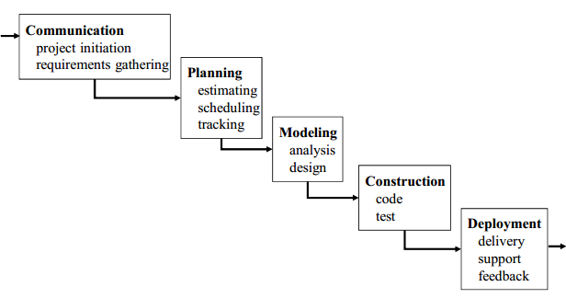

Slide 5
ADVANTAGES
DISADVANTAGES
Simple & Easy to Understand
Difficult to go Back and Change something
Easy to Manage
No Working Software until Late Stages of SDLC
Phase don’t Overlap
Risk and Uncertainty
Best for Small Projects
Not Suitable for Complex and Object Oriented Projects

Slide 6
Impact on testing
Testing Starts late in the SDLC
Single Testing Phase
Leads to “blocking Stages”

Slide 7
Development Models
Incremental process modes

Slide 8
Incremental process modes
Combines elements of the waterfall model applied in an iterative fashion
Each linear sequence produces deliverable “increments” of the software
The first increment is often a core product
The core product is used by the customer (or undergoes detailed evaluation)
Based on evaluation results, a plan is developed for the next increment

Slide 9
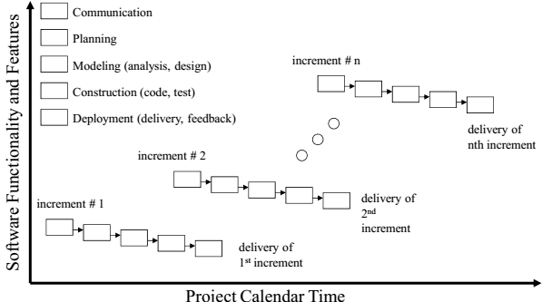

Slide 10
ADVANTAGES
DISADVANTAGES
Generates working software quickly and early during the software life cycle
Needs good planning and design
This model is more flexible – less costly to change scope and requirements. It is easier to test and debug during a smaller iteration
Needs a clear and complete definition of the whole system before it can be broken down and built incrementally
In this model customer can respond to each built. Lowers initial delivery cost
Total cost is higher than waterfall
Easier to manage risk because risky pieces are identified and handled during it’d iteration

Slide 11
When to use
This model can be used when the requirements of the complete system are clearly defined and understood
Major requirements must be defined; however, some details can evolve with time
There is a need to get a product to the market early
A new technology is being used
Resources with needed skill set are not available

Slide 12
Development Models
RAD model

Slide 13
THE RAD model
RAD model is Rapid Application Development model.
It is a type of incremental model. In RAD model the components or functions are developed in parallel as if they were mini projects.
Uses a component-based construction approach
This can quickly give the customer something to see and use and to provide feedback regarding the delivery and their requirements if requirements are well understood and project scope is constrained

Slide 14
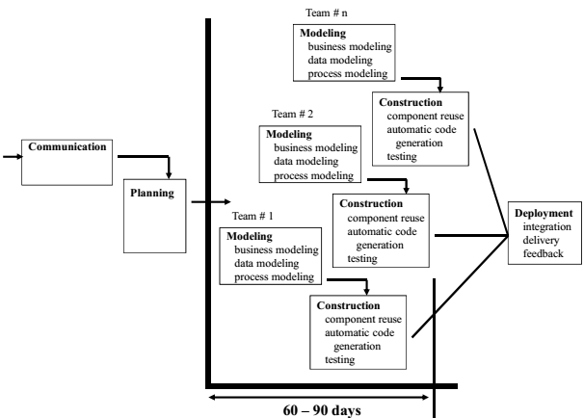

Slide 15
ADVANTAGES
DISADVANTAGES
Reduced development time
Depends on strong team and individual performances for identifying business requirements
Increases reusability of components
Only system that can be modularized can be built using RAD
Quick initial reviews occur & Encourages customer feedback
Requires skilled developers/designers & High dependency on modeling skills
Integration from very beginning solves a lot of integration issues
Inapplicable to cheaper projects as cost of modeling and automated code generation is very high

Slide 16
When to use
RAD should be used when there is a need to create a system that can be modularized in 2-3 months of time
It should be used if there’s high availability of designers for modeling and the budget is high enough to afford their cost along with the cost of automated code generating tools
RAD SDLC model should be chosen only if resources with high business knowledge are available and there is a need to produce the system in a short span of time (2-3 months)

Slide 17
Evolutionary process models
Evolutionary models are iterative type models
Software, like all complex systems, evolves over a period of time
Allow to develop more complete versions of the software
Different Evolutionary Process Models
The Prototyping Model
The Spiral Model
Concurrent Development Model

Slide 18
The Prototyping model
Prototype is defined as first or preliminary form using which other forms are copied or derived
Prototype model is a set of general objectives for software
It does not identify the requirements like detailed input, output
It is software working model of limited functionality & working programs are quickly produced

Slide 19
Quick Plan
Construction of Prototype
Deployment, Delivery & Feedback
Modeling Quick Design
Communication
Notes:
Communication In this phase, developer and customer meet and discuss the overall objectives of the software.
2. Quick design
Quick design is implemented when requirements are known.
It includes only the important aspects like input and output format of the software.
It focuses on those aspects which are visible to the user rather than the detailed plan.
It helps to construct a prototype.
3. Modeling quick design
This phase gives the clear idea about the development of software because the software is now built.
It allows the developer to better understand the exact requirements.
4. Construction of prototype The prototype is evaluated by the customer itself. 5. Deployment, delivery, feedback
If the user is not satisfied with current prototype then it refines according to the requirements of the user.
The process of refining the prototype is repeated until all the requirements of users are met.
When the users are satisfied with the developed prototype then the system is developed on the basis of final prototype.

Slide 20
ADVANTAGES
DISADVANTAGES
Prototype model need not know the detailed input, output, processes, adaptability of operating system and full machine interaction
The client involvement is more and it is not always considered by the developer
In the development process of this model users are actively involved
It is a slow process because it takes more time for development
Errors are detected much earlier.
Gives quick user feedback for better solutions.
Practically, this methodology may increase the complexity of the system as scope of the system may expand beyond original plans
It identifies the missing functionality easily. It also identifies the confusing or difficult functions
Incomplete application may cause application not to be used as the full system was designed Incomplete or inadequate problem analysis.

Slide 21
When to use
Prototype model should be used when the desired system needs to have a lot of interaction with the end users
Typically, online systems, web interfaces have a very high amount of interaction with end users, are best suited for Prototype model. It might take a while for a system to be built that allows ease of use and needs minimal training for the end user
Prototyping ensures that the end users constantly work with the system and provide a feedback which is incorporated in the prototype to result in a useable system. They are excellent for designing good human computer interface systems

